Slide 1
TUTOR PREP WORK
Familiarize yourself with today’s lesson.
During the Intro Section, you will introduce your learners to the idea that they too can become a Tutor on the Schoolhouse platform!
Learner recruitment for the upcoming month has opened — please encourage your learners to register for another Schoolhouse program in today’s session!

Slide 2


While You’re Waiting…
Type in the chat:
What movie or TV show do you wish you could watch again for the first time? Why?
It's tricky for your tutor to help you as an anonymous black box—please turn on your camera if you can!
Notes:
[This slide is intended to be up in the first few minutes BEFORE your session officially starts as you wait for everyone to trickle in and arrive]
As the tutor, you should type your own answer in the chat and then verbally engage with learners as they arrive (ask them why, ask them to describe more)– use this entry to set the tone as a welcoming learning community!

Slide 3

MATH SAT BOOTCAMP
WEEK 3, DAY 1

Slide 4
WELCOME QUESTION
Congrats! We’re halfway through the Bootcamp!
What is going well in your studying? What could be going better? Anything you want to change for the next two weeks?
Notes:
[Use this question to foster a learning community and build relationships with the learners in your cohort]
Encourage learners to come off mute to share– ex answers: “I missed the last session, so really want to get to 100% of the remaining sessions.” or “I haven’t been getting enough sleep and I know that will help me feel better about taking the test.”
Build relationships: Don’t be afraid to linger on this section a little bit and ask follow-up questions. This is how we create a learning community!

Slide 5

DON’T FORGET
Remember this fun way to get extra practice:
PlaySAT is a daily SAT game created by a former Schoolhouse engineer! PlaySAT is managed by volunteers and has 3 new questions to practice with everyday!
Notes:
Share this link with learners: https://schoolhouse.world/games/play-sat

Slide 6
AGENDA
Geometry & Trigonometry Practice 30 min
Geometry & Trigonometry Practice Test 21 min
Review Practice Test 19 min
Notes:
Provide learners with an overview of the plan for the day.

Slide 7
TARGETED GROUP PRACTICE
30 minutes
Notes:
Follow “Targeted Group Practice Instructions” guidance here.

Slide 8
Desmos Warm-Up
3-4 minutes

Slide 9
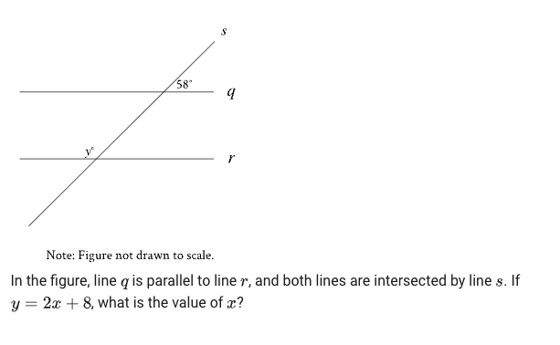
DESMOS WARM-UP
Brainstorm how Desmos could help you solve this problem.
Notes:
Put link to Desmos in the chat for learners: https://www.desmos.com/testing/cb-digital-sat/graphing
Ask learners to take two minutes to give the problem a try.
Tutor should ask if a learner can demonstrate how they used Desmos to approach the problem. If learners are unsure, tutor can demonstrate using the steps on next slide.

Slide 10
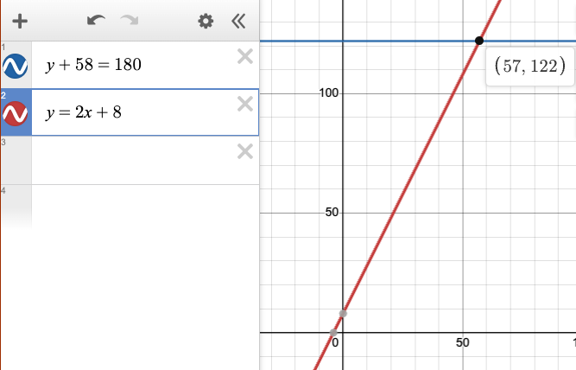
DESMOS DEMO
t
Steps to solve:
Consider interior + supplementary angles add to 180 (to get blue equation)
Input system of equations
Zoom out to find intersection point, which is solution
*Not a drawing of the original lines in the question! These lines represent equations
Notes:
If learners were unsure how to use Desmos to solve, tutor should go to this link and demonstrate how to use Desmos to find the answer: https://www.desmos.com/testing/cb-digital-sat/graphing
The answer is the value of the x-coordinate, x=57

Slide 11
GEOMETRY & TRIGONOMETRY
FOCUS SKILL #1
Notes:
Follow “Targeted Group Practice Instructions” guidance here.

Slide 12
FOCUS SKILL #1
Right Triangles
and Trigonometry
Notes:
Follow “Targeted Group Practice Instructions” guidance here.

Slide 13
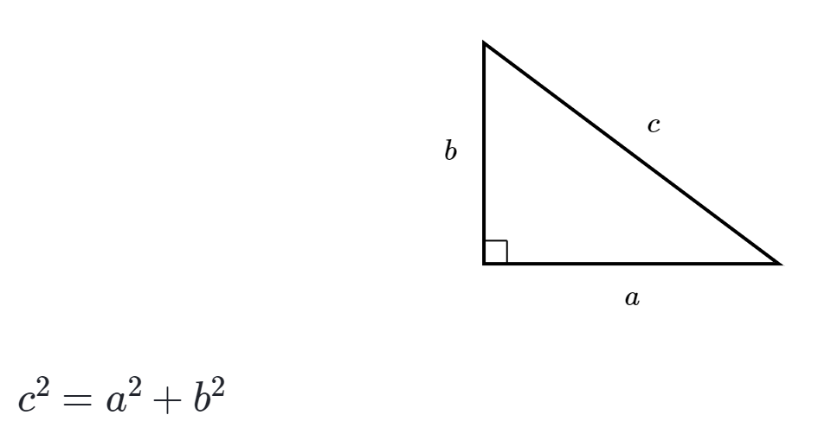
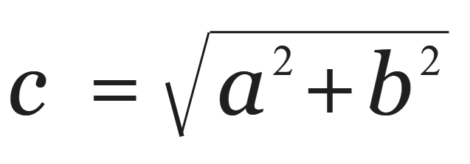
Pythagorean Theorem
Used to find the side lengths
of a RIGHT triangle
a = leg
b = leg
c = hypotenuse
See also: Pythagorean triples (e.g., 3, 4, 5)
Notes:
Pythagorean Theorem used on RIGHT triangles only

Slide 14
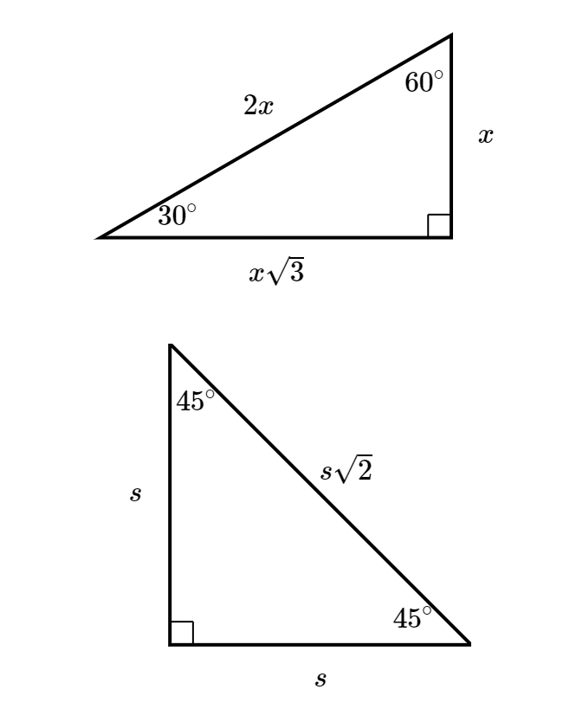

Special Right Triangles
Very (very!) common—
be able to recognize them
Note: Questions might also ask you about the measurement of a side length when you are only given one side.
If so, you need to find x.
30-60-90
triangle
45-45-90 triangle
Notes:
These are located in the SAT reference table, however you need to be able to recognize them- commonly by the angles
Then you need to apply the side length relationships

Slide 15
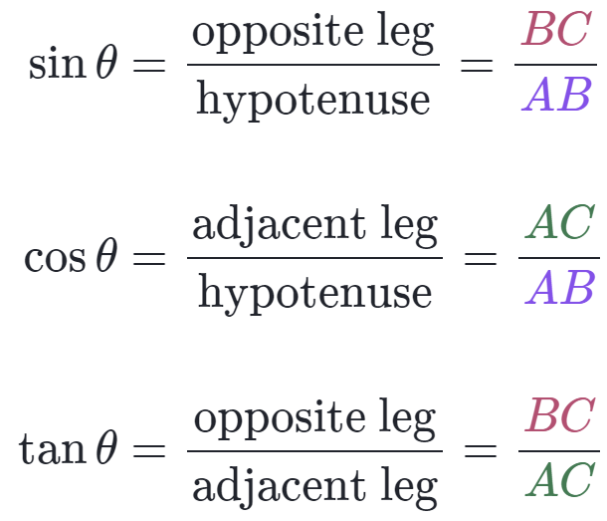
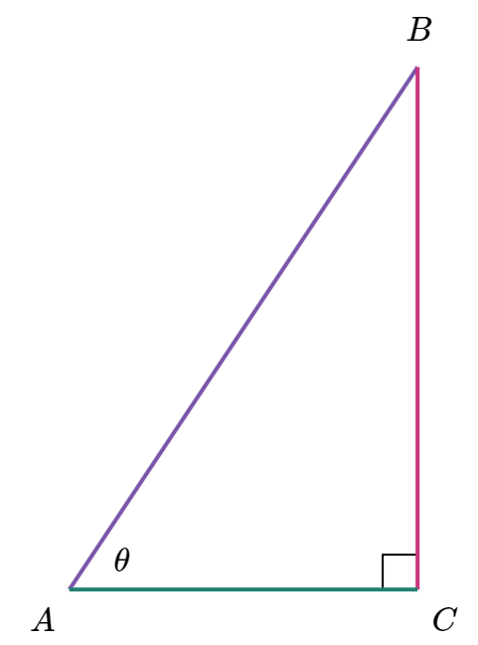
SOHCAHTOA
Based off of the location of θ and the side lengths of a right triangle
Hypotenuse
(always across from right angle)
Opposite
Adjacent
Notes:
Memorize SOH CAH TOA

Slide 16
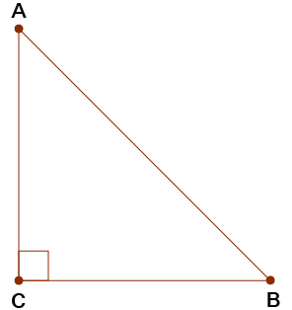
Trigonometry Ratios
Sine, cosine, and tangent represent ratios of side lengths—so can be used to find them!
For example if sin(B) = 3/5
The side lengths of the opposite side and the hypotenuse are in a 3/5 ratio (9/15)
15
9
Hypotenuse
Opposite
Adjacent
Notes:
Understand that the SOH CAH TOA fractions do NOT always correlate to the actual side lengths! They are RATIOS of the side lengths, and you need to recognize that for harder questions!

Slide 17

Last Tips
Understand what the problem is looking for before you jump in!
If you’re not provided with a diagram, it can help to draw one and fill in all the information you’re given.
Similar Triangles vs. Congruent Triangles
(angles are equal) (angles and sides are equal)
15
Also, one rule that sometimes comes up:
Notes:
Understand that the SOH CAH TOA fractions do NOT always correlate to the actual side lengths! They are RATIOS of the side lengths, and you need to recognize that for harder questions!

Slide 18
PRACTICE PROBLEM 1: I DO
Follow directions here to copy and paste selected practice problem into this slide. DELETE THIS RED TEXT after updating slide.
Notes:
Follow “Targeted Group Practice Instructions” guidance here.

Slide 19
PRACTICE PROBLEM 2: WE DO
Follow directions here to copy and paste selected practice problem into this slide. DELETE THIS RED TEXT after updating slide.
Notes:
Follow “Targeted Group Practice Instructions” guidance here.

Slide 20
If time permits
PRACTICE PROBLEM 3: WE DO
Follow directions here to copy and paste selected practice problem into this slide. DELETE THIS RED TEXT after updating slide.
Notes:
Follow “Targeted Group Practice Instructions” guidance here.

Slide 21
GEOMETRY & TRIGONOMETRY
FOCUS SKILL #2
Notes:
Follow “Targeted Group Practice Instructions” guidance here.

Slide 22
FOCUS SKILL #2
CIRCLES
Notes:
Follow “Targeted Group Practice Instructions” guidance here.

Slide 23
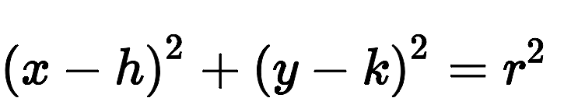
TIPS FOR THIS TYPE OF QUESTION
π radians = 180°
The equation of a circle is:
x = x-coordinate
y = y-coordinate
r = radius
Notes:
Follow “Targeted Group Practice Instructions” guidance here.

Slide 24
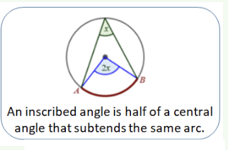
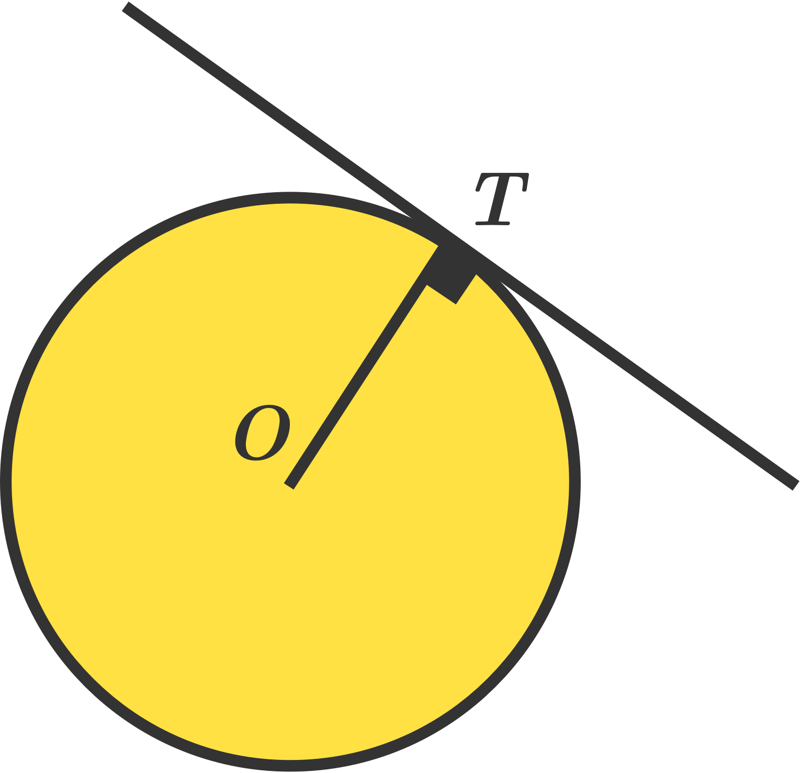
Tangent lines are perpendicular.
TIPS FOR THIS TYPE OF QUESTION
Notes:
Follow “Targeted Group Practice Instructions” guidance here.

Slide 25
PRACTICE PROBLEM 1: I DO
Follow directions here to copy and paste selected practice problem into this slide. DELETE THIS RED TEXT after updating slide.
Notes:
Follow “Targeted Group Practice Instructions” guidance here.

Slide 26
PRACTICE PROBLEM 2: WE DO
Follow directions here to copy and paste selected practice problem into this slide. DELETE THIS RED TEXT after updating slide.
Notes:
Follow “Targeted Group Practice Instructions” guidance here.

Slide 27
If time permits
PRACTICE PROBLEM 3: WE DO
Follow directions here to copy and paste selected practice problem into this slide. DELETE THIS RED TEXT after updating slide.
Notes:
Follow “Targeted Group Practice Instructions” guidance here.

Slide 28
PRACTICE TEST
21 minutes
Notes:
Follow “Practice Test Guidance” here.

Slide 29
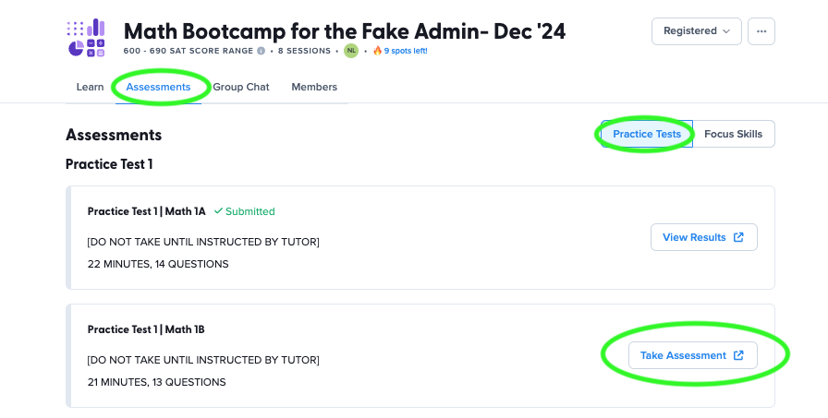
GEOMETRY & TRIGONOMETRY PRACTICE TEST
<insert screenshot of how to find score>
Notes:
Follow “Practice Test Guidance” here.
Today’s Practice Test is Geometry & Trigonometry Practice Test

Slide 30

TIMER
21 minutes!
Notes:
Follow “Practice Test Guidance” here.
Click on “TIMER” text on slide for link to timer.

Slide 31
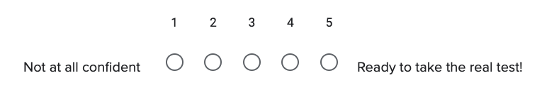
REFLECTION
How did you feel about the Practice Test?
Notes:
Follow “Practice Test Guidance” here.

Slide 32
REVIEW
PRACTICE TEST
19 minutes
Notes:
Follow “Review Practice Test Guidance” here.

Slide 33
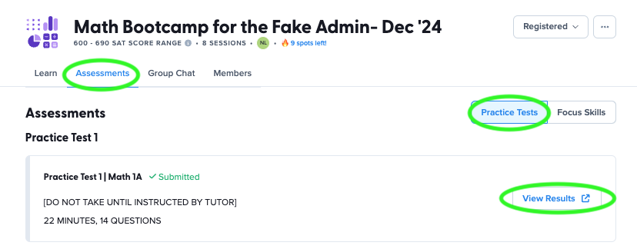
VIEW YOUR RESULTS
Notes:
Follow “Review Practice Test Guidance” here.

Slide 34
REVIEW PRACTICE TEST
Everyone will take turns sharing their ideas for solving the problem.
Please do not be afraid to share your thinking even if you got the answer wrong.
We likely have common misconceptions and it will be helpful to talk through why the mistake happened.
Notes:
Follow “Review Practice Test Guidance” here.
[Tutor should share screen to show problems and then ask learners to use Zoom annotate to walk through their thinking.]

Slide 35
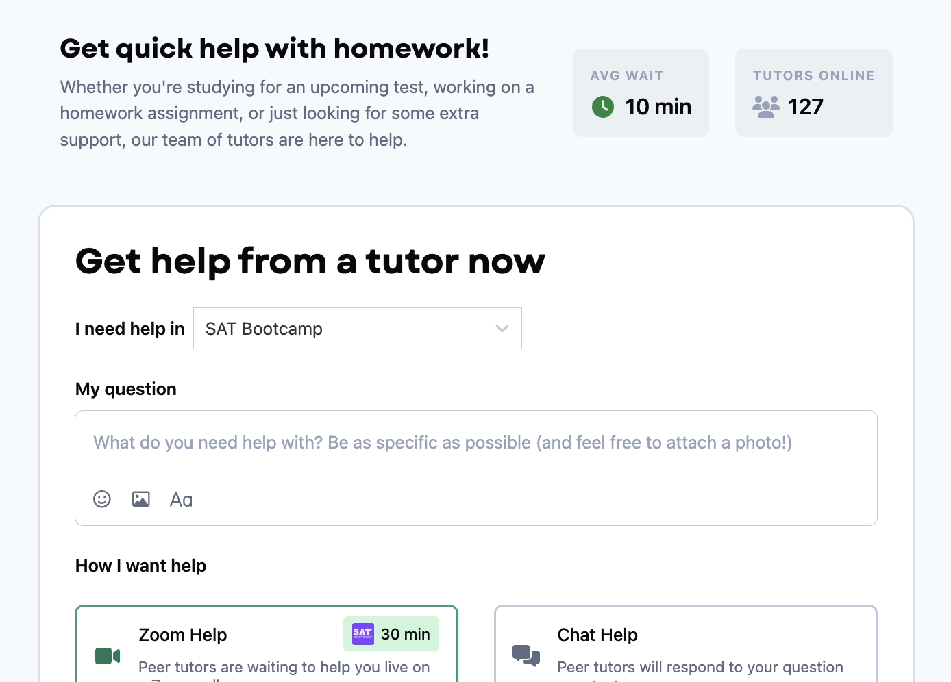
IF WE RUN OUT OF TIME
You can always use Homework Help for extra support on questions we didn’t get a chance to cover!
Select “SAT Bootcamp” as subject
Notes:
[Share the link to the Homework Help tab with your learners in the chat]: https://schoolhouse.world/dashboard/live-help

Slide 36
CLOSING & NEXT STEPS
5 minutes
Notes:
[Emphasize that you would like learners to have cameras on as you head into introductions to help create a warm learning community]

Slide 37
BEFORE NEXT TIME:
Practice skills you struggled with for at least 30 minutes on Khan Academy this week. I’ll review how on the next slide!
Ask questions in “Homework Help” (select “SAT Bootcamp” as subject) if you’d like extra tutoring on a specific area.
Notes:
Talk through the bullets on this slide
Link: https://schoolhouse.world/dashboard/live-help?tab=get-help

Slide 38
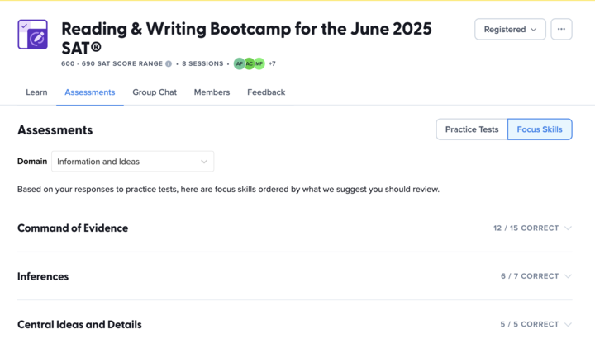
Quick Review: If Needed
TARGET YOUR EXTRA PRACTICE
Notes:
I want to show you this cool feature that can help you plan your independent study practice for this week!
From your Series page:
Click on ‘Assessments.’
Then, click on ‘Focus Skills’ in the tab on the top.
Then, select the Domain focus for the week.
Week 1: Algebra
Week 2: Advanced Math
Week 3: Problem-Solving & Data Analysis
Week 4: Geometry & Trigonometry
Look at which Focus Skills you had the most missed questions for and target your practice there!

Slide 39
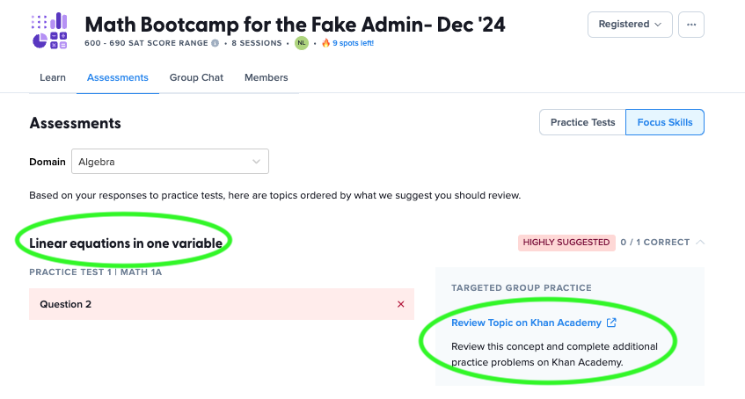
Quick Review: If Needed
HEAD TO KHAN ACADEMY
Notes:
If you click into the “Focus Skill,” you’ll see the option to click on the link to Khan Academy.
Share screen to show focus Domain.
Remind learners which level of practice to complete on Khan Academy:
Foundations: recommended for below 400
Medium: recommended for 400-590 score band
Advanced: recommended for 600-690 score band

Slide 40
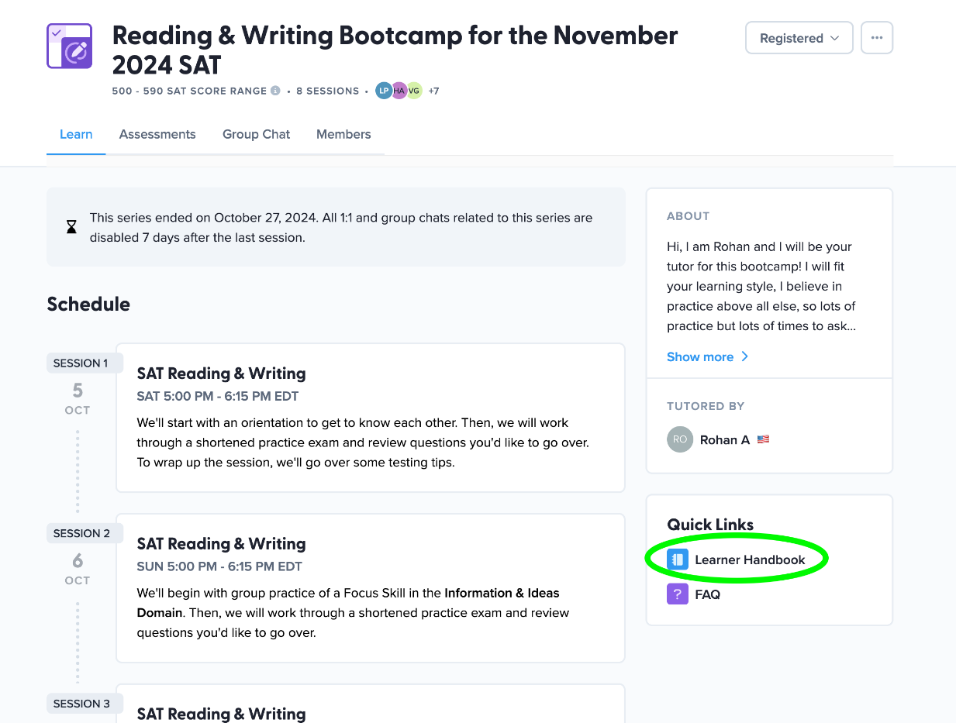
Quick Review: If Needed
LEARNER HANDBOOK
If you need a refresher on these instructions, you can click on the Learner Handbook on our series page!
Notes:
Show learners how to find the Learner Handbook

Slide 41
SEE YOU NEXT TIME!
✏️ Jot down your study plan for this week! When will you schedule your Khan Academy practice? What is your goal number of minutes?
💫 Here’s the plan for our next session, our last session together!
70 Quick Tips & Bluebook Full Practice Test
Be sure that you have downloaded Bluebook!

Slide 42
TUTOR AFTER WORK
Provide each learner with feedback via the platform— personalize the feedback if possible.
Sharing feedback can help boost learner attendance at future sessions!

